Slide 1


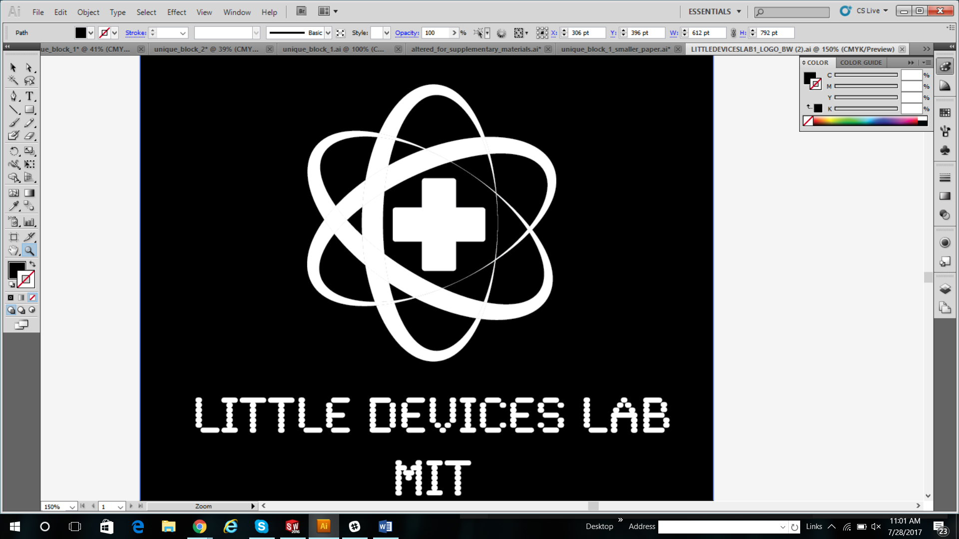
BIOREACTOR
August 2017

Slide 2
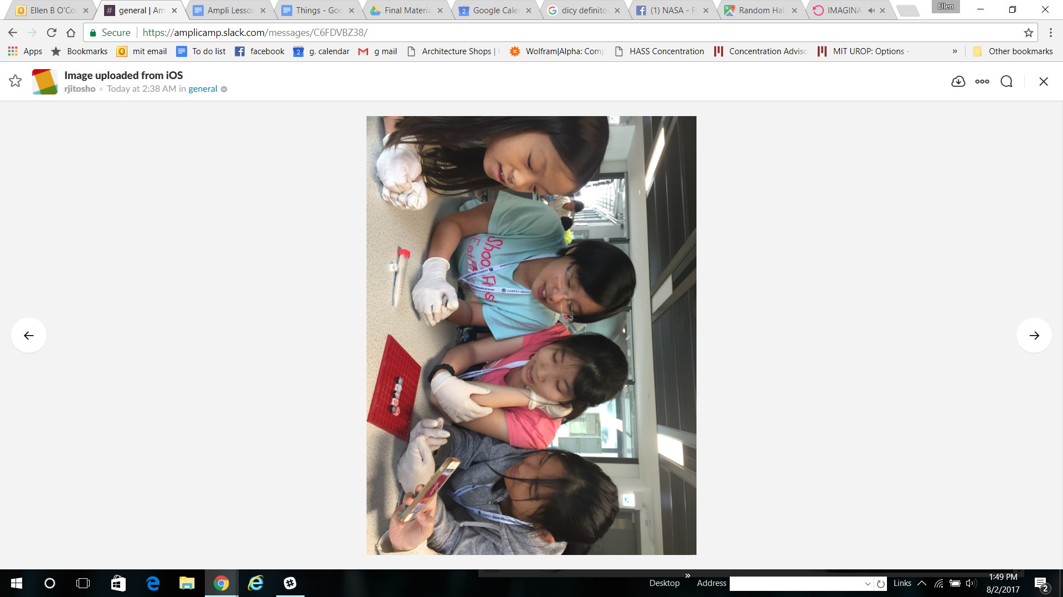
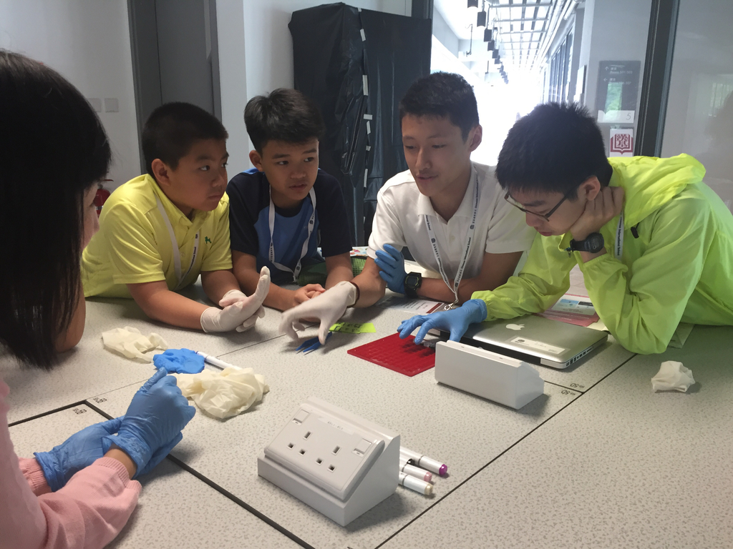
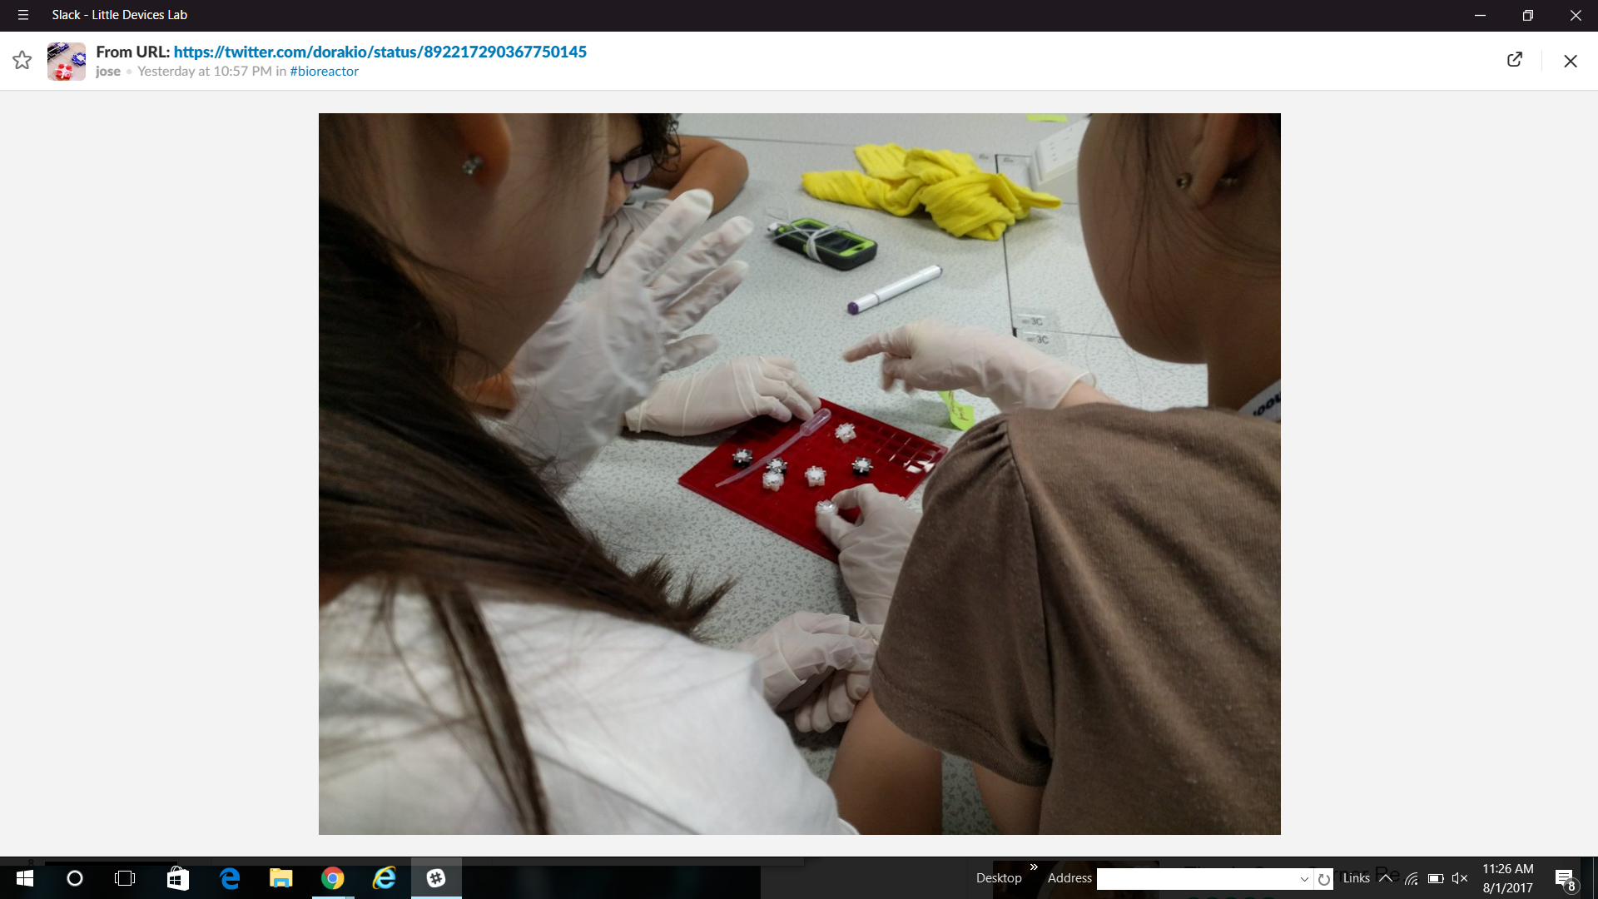
Photos from the week
Credit: Akio lida Twitter @dorakio
Credit: Rianna Jitosho
Credit: Rianna Jitosho
Notes:
https://twitter.com/dorakio/status/892214457274740736
https://twitter.com/dorakio/status/892217290367750145
rianna Jitosho

Slide 3
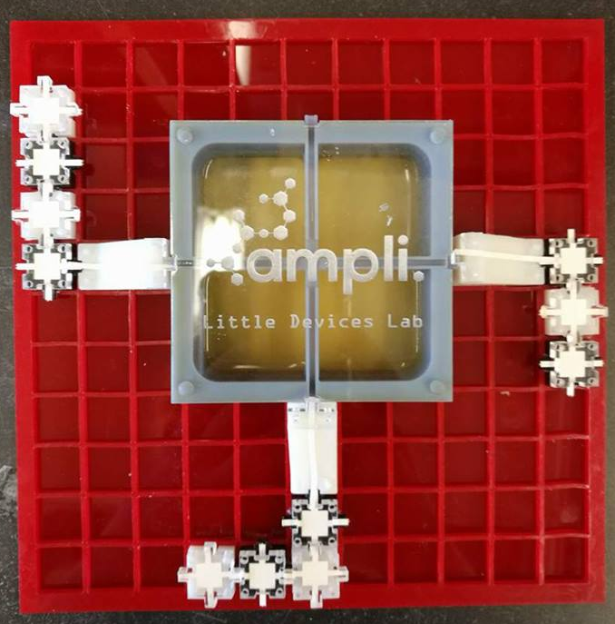
Introductory Level Ampli activities:
Free-form experiment design:
Test flow with food coloring
Test pH of ethanol
Study fermentation:
Examine & quantify ethanol production
Make ethanol

Slide 4
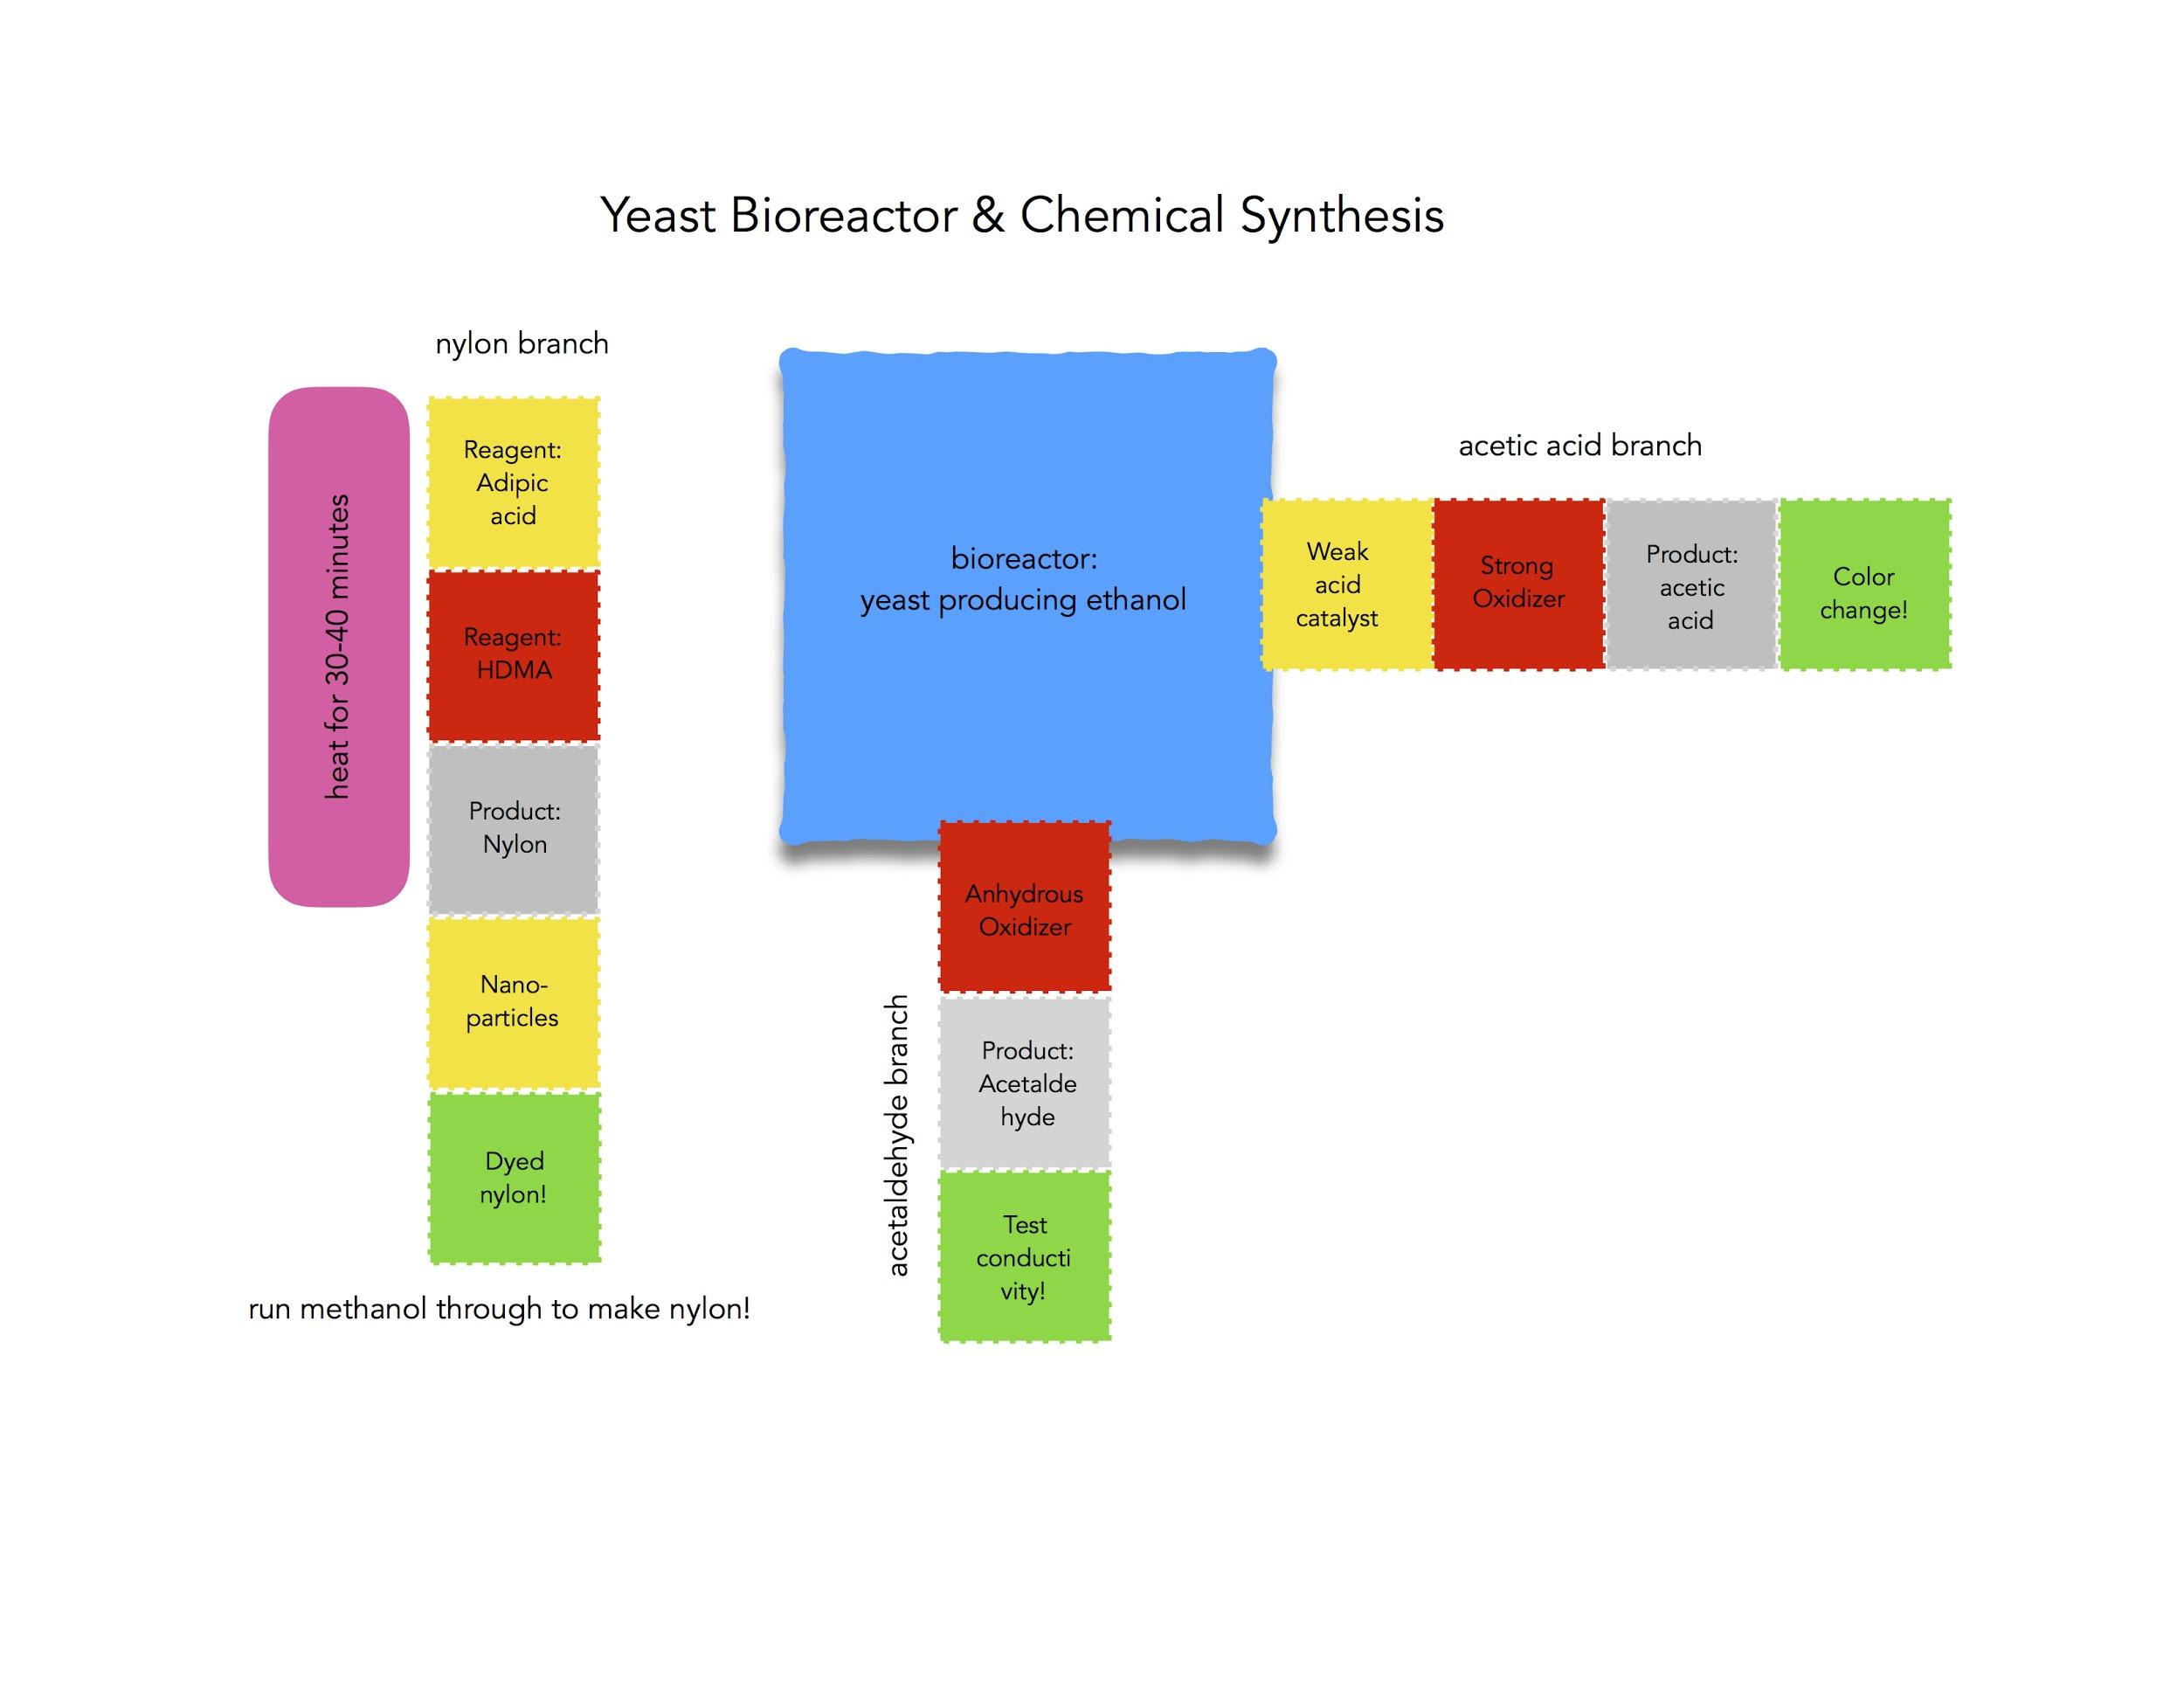
Advanced Level Ampli Activities:
Study Fermentation
Made ethanol with water, yeast, and sugar
Downstream reactions
Introduce Ampli system with food color flow
Perform 2 chemical reactions using the Ampli system
Evaluate success of the reactions using pH and multimeters

Slide 5
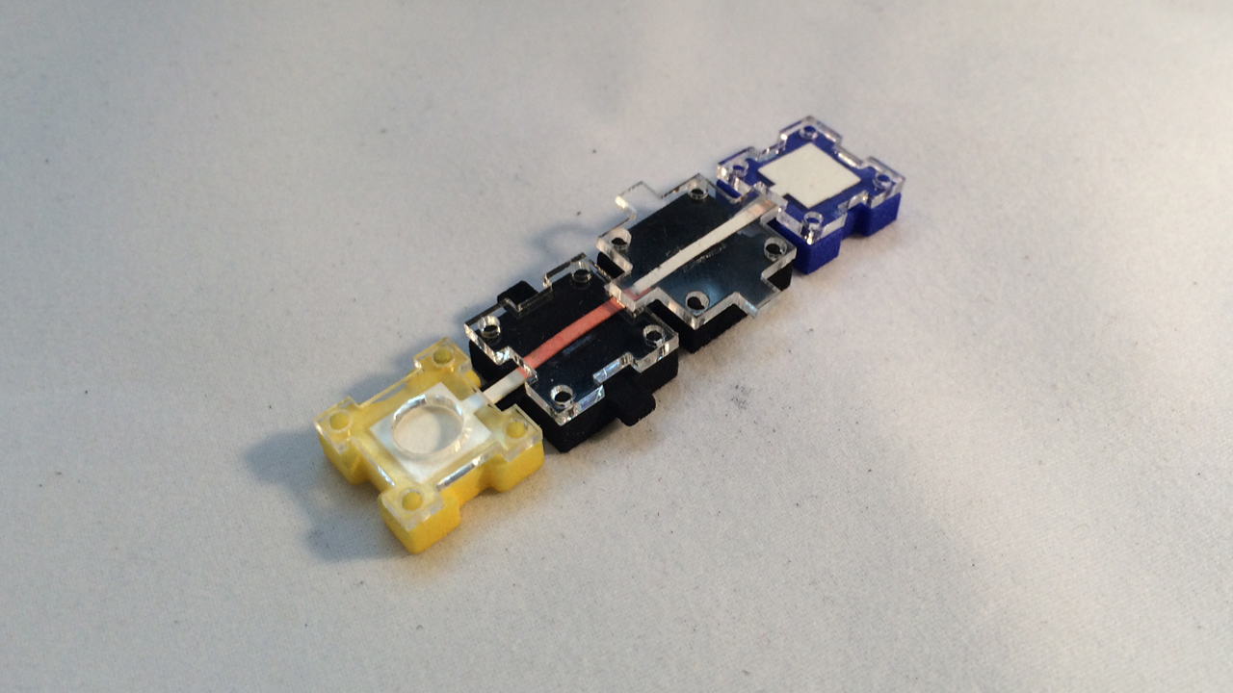
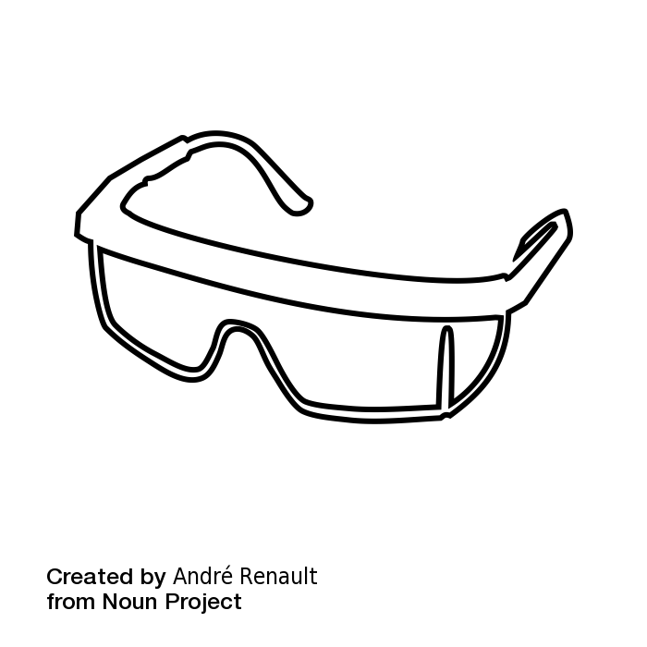
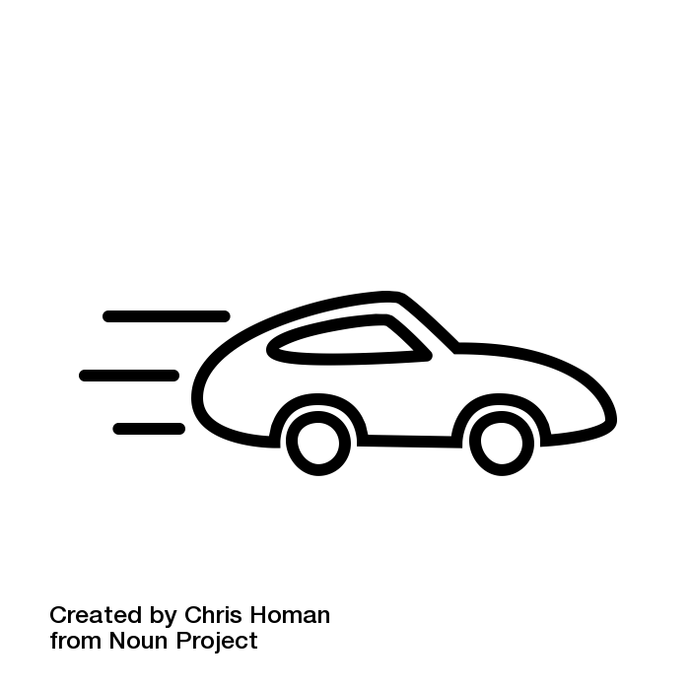
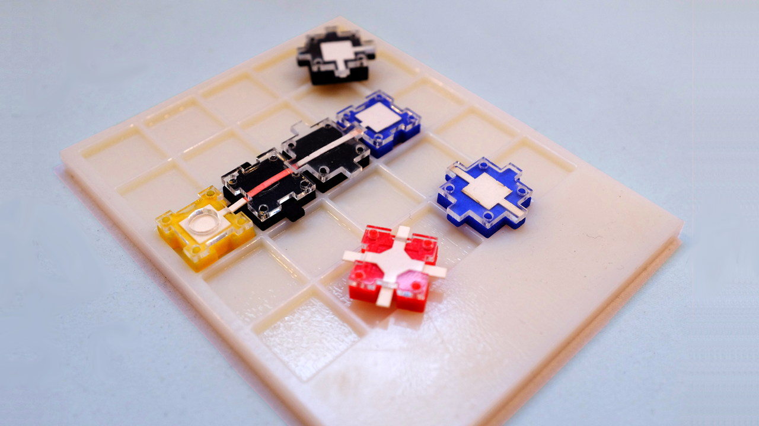
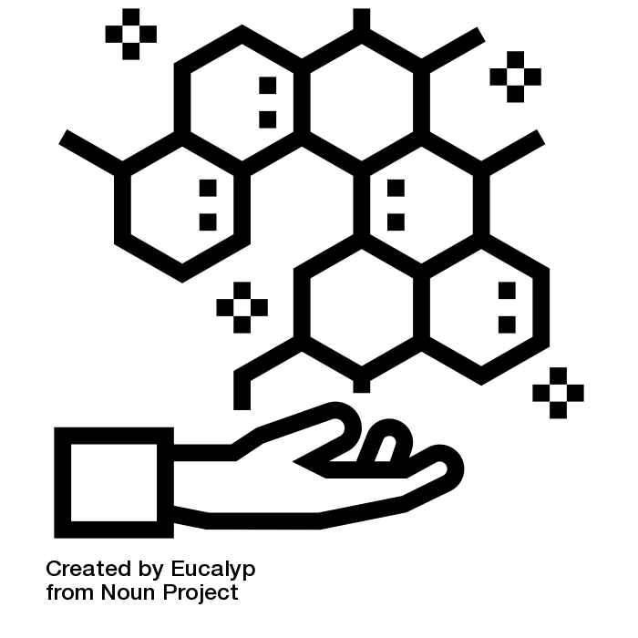
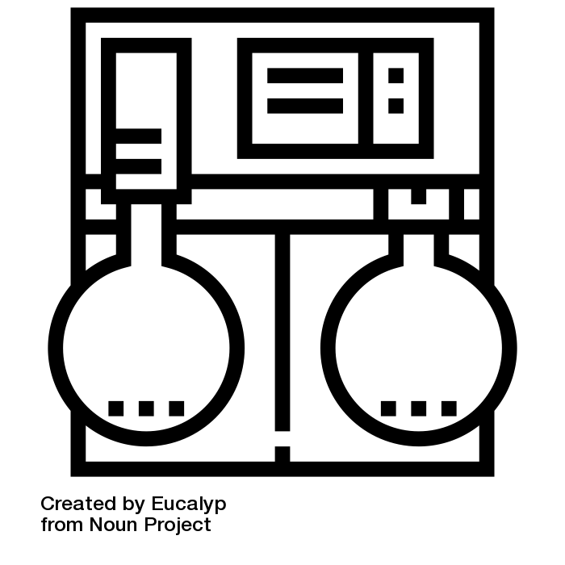
What Makes Ampli Unique?
Safety
Speed
Equipment
Programmable Biochemistry
Notes:
http://makerfaire.com/maker/entry/52132/
Safety - chemicals are easily contained and risk is significantly reduced. This allows students to work with chemicals that they otherwise would not have access to.
Speed - it has been experimentally observed that reactions tend to proceed more quickly on paper than with traditional lab equipment.
Equipment - traditional expensive lab equipment is not necessary.
Freedom/Programmable Biochemistry - kids are able to experiment with directions of flow paths, interactions between paths, length of reaction papers, and many other variables that are not possible with traditional lab equipment. Students are able to stop reactions at certain points which something that is tricky/impossible with traditional methods.
*You can also talk about the modular nature of Ampli and how it lends itself well to programmable biochemistry
Idea by Chris Homan from the Noun Project

Slide 6
Implementing Ampli in the Classroom
You’ve asked us:
Why don’t the blocks fit together sometimes?
The version of Ampli we used last week is a Beta version. The Little Devices Lab at MIT is continuously developing the Ampli system to improve usability.
How long does it take to prepare a kit for classroom use?
Ampli is designed to be ready-to-react on opening. Blocks will come pre-spotted with chemicals, and can be refilled after use. Projects should require little to no preparation before class.
What kinds of Ampli projects could be experienced in a 30 minute class session or science club meeting? What other kinds of Ampli projects are there?

Slide 7
Additional Activities
August 2017

Slide 8
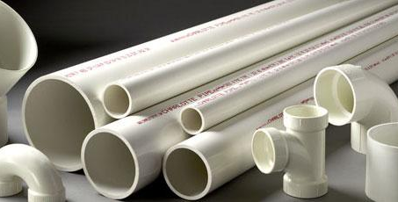
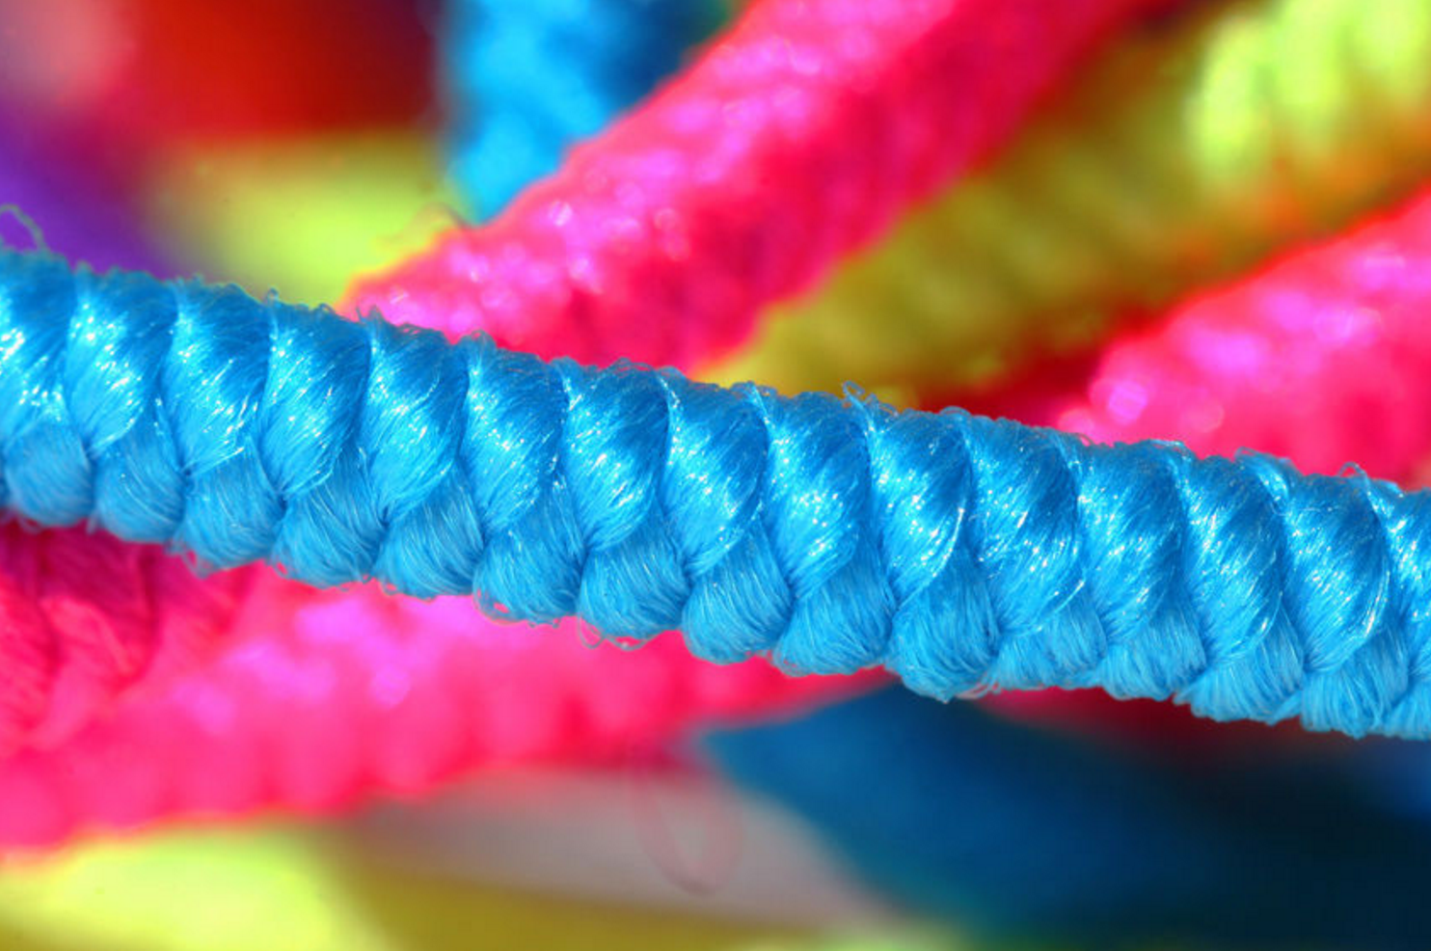
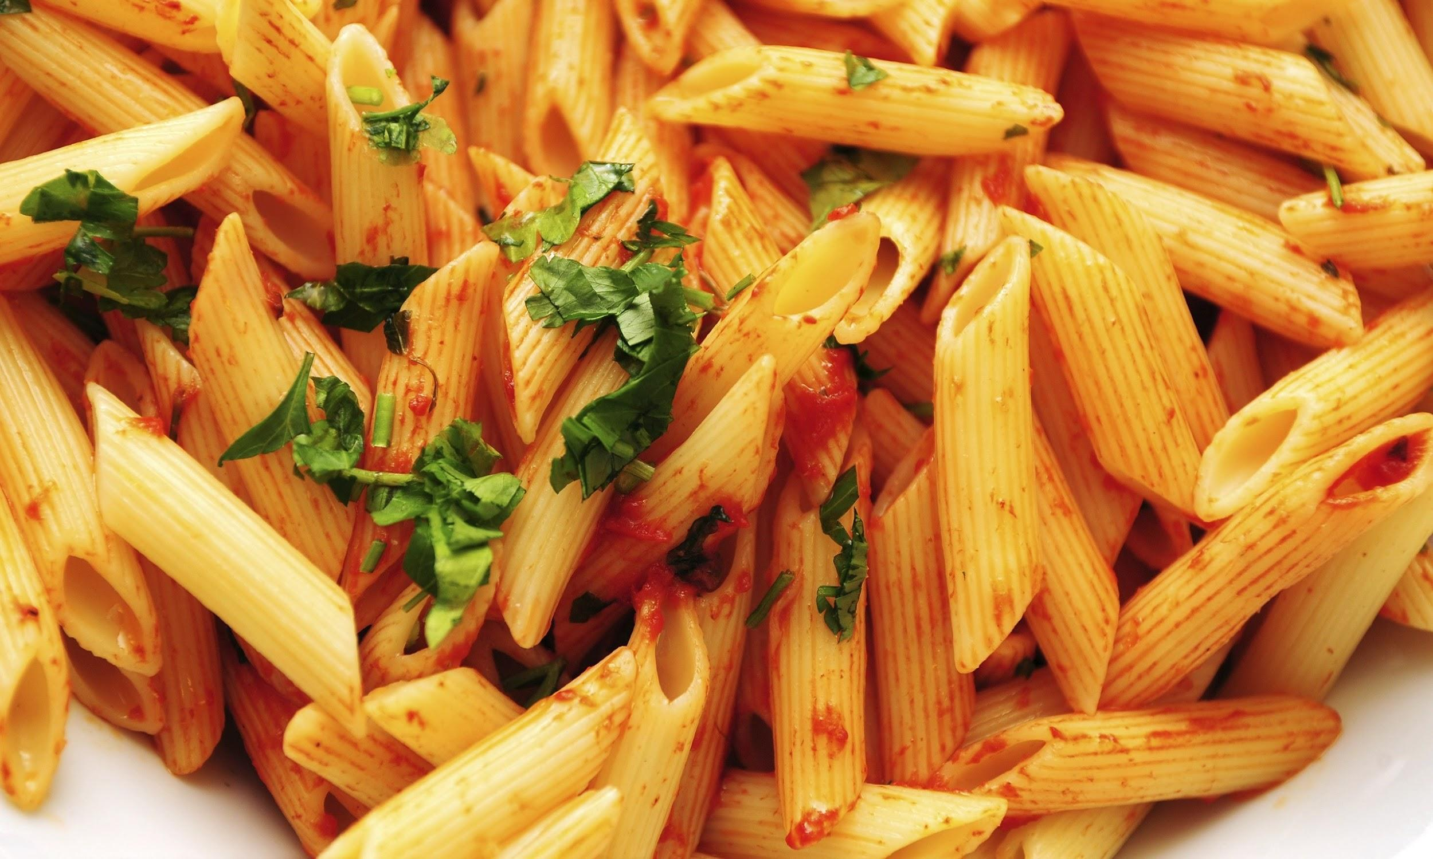
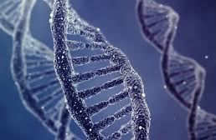
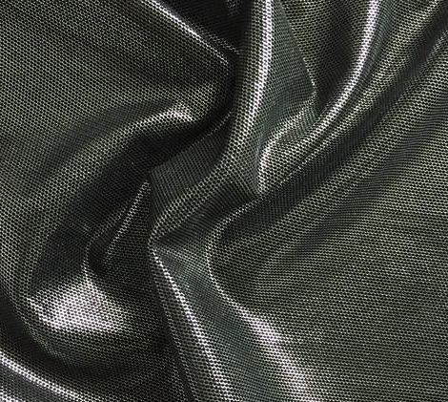
Monomers are small molecules that are able to join with other small molecules (sometimes the same, sometimes different) in a chain to form very long molecules, often with special properties. These are called polymers.
Polymers
Notes:
Polymers

Slide 9
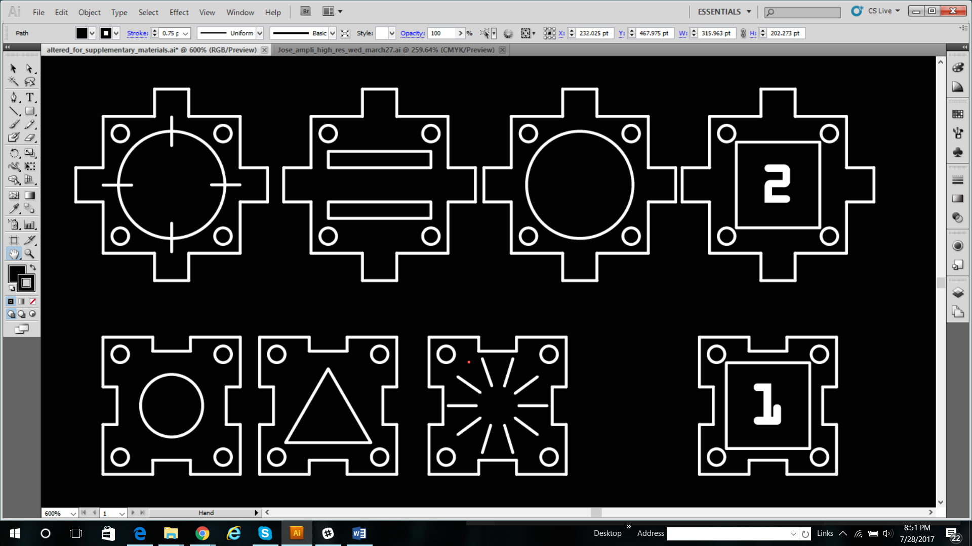
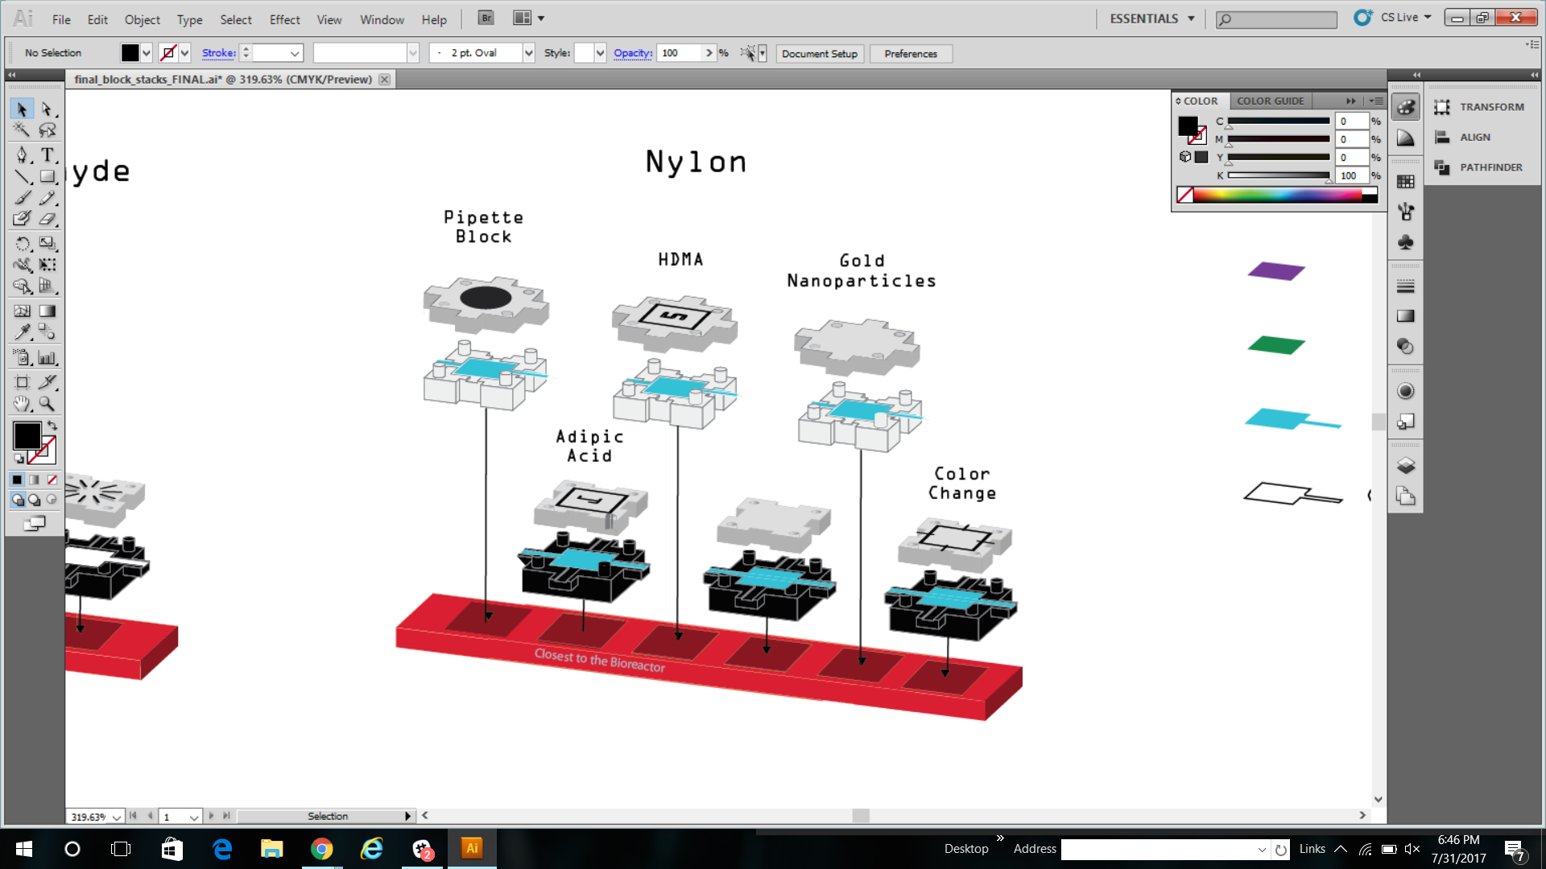
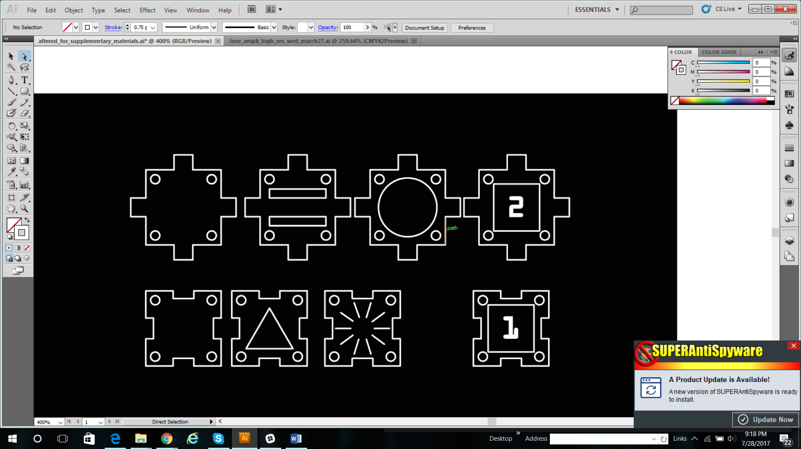
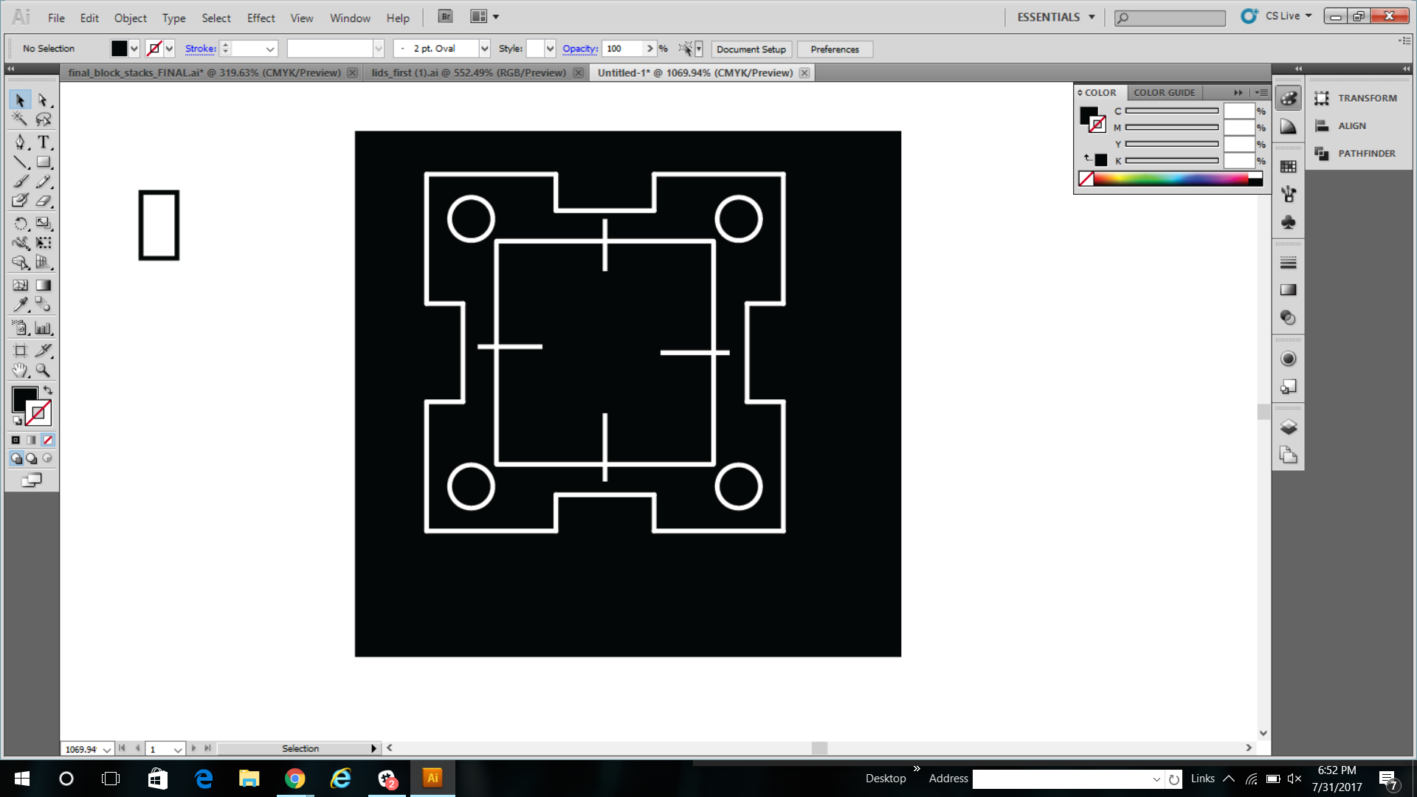
Polymers:
Blank: pipette block (hole
In the lid!!)
Adipic acid
HMDA
Blank
Gold Nanoparticles
Color change

Slide 10
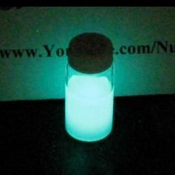
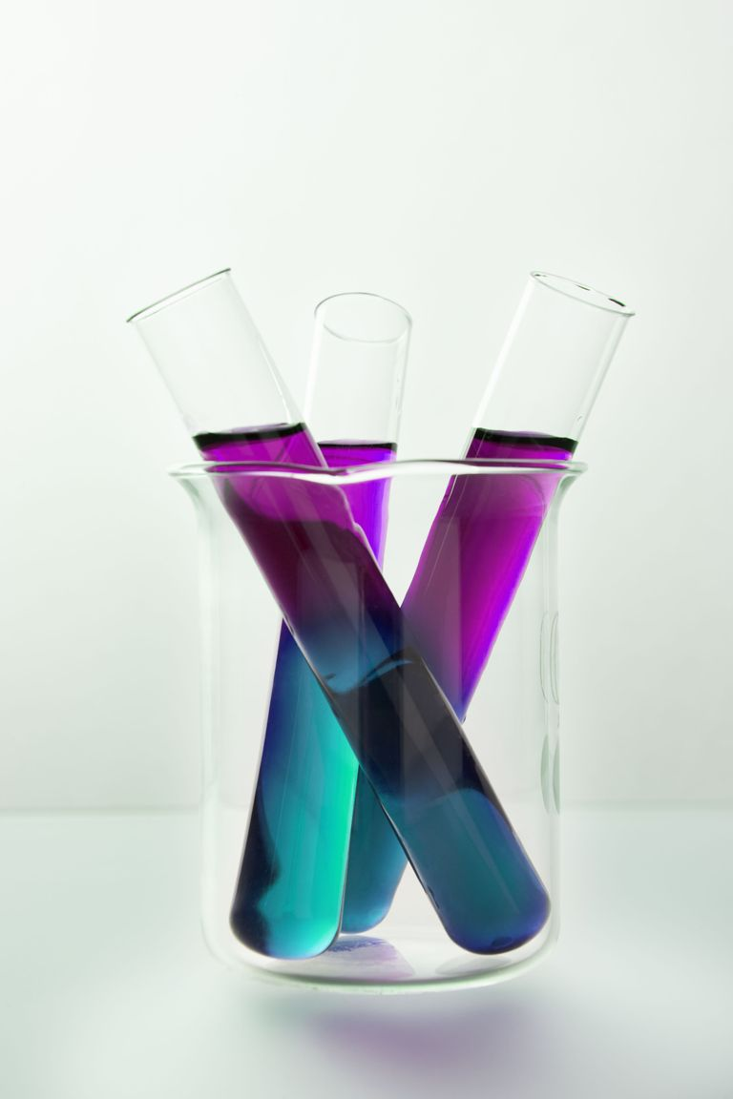
Short Ampli Chemistry Activities
“Glow Stick Chemistry”
TCPO gives many glow sticks their characteristic glow. Make your own chemiluminescence on paper!
Oxidation-Reduction with Multiple Color Changes
NaOH and KMnO4 drive this reaction on paper with purple, blue, green, and orange color changes.
TCPO Dye sodium acetate H2O2->GLOW
KMnO4 NaOH/Glu Dose 1 NaOH/Glu Dose 2 Precip.
Each would require a lesson of 30 minutes to an hour, with visible results
Notes:
**To be finished with more-detailed chemistry blocks**

Slide 11
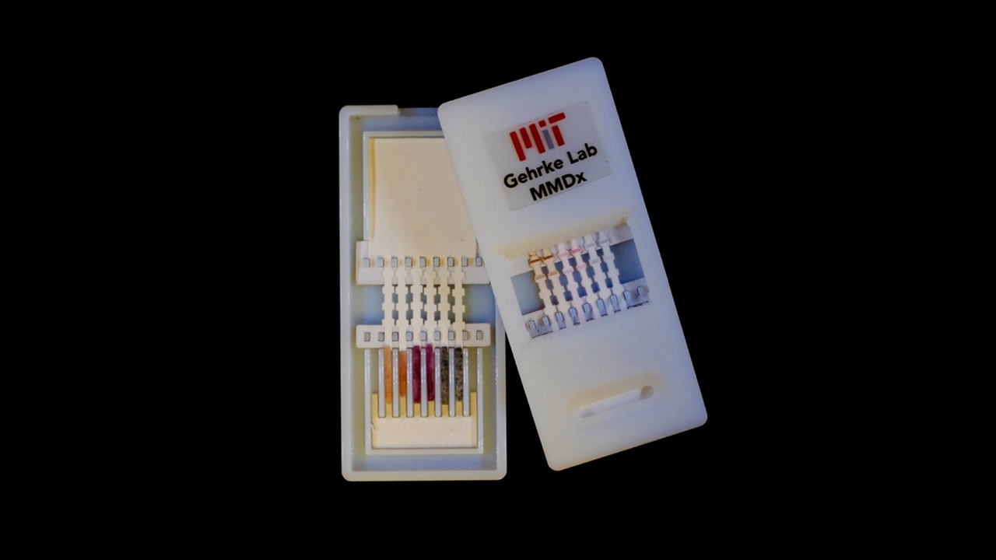
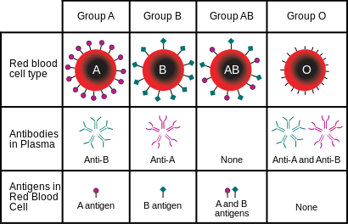
Short Ampli Health Activities
There are lots of activities you could do with Ampli kits that are relevant to health sciences, and could be done in about 30 minutes in the classroom with minimal preparation. Some examples:
Ampli Diagnostics
Create and test Ampli diagnostics for virus antigens, cancer markers, drug adherence, and more using conjugated nanoparticles
Blood-Type Teaching
Educational blood-typing activities to explore antigen compatibility and simulate real-world health and forensic scenarios

Slide 12
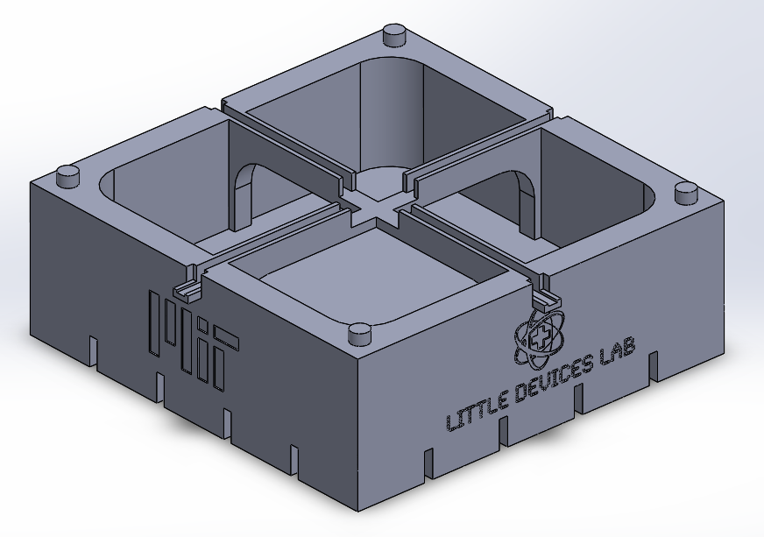
Overnight Ampli Bioreactor Activities
Unlock the full potential of the Ampli bioreactor with activities done over two short class periods, separated by overnight incubation. Use organism culture methods to explore topics with great potential for creativity and many applications.

Slide 13
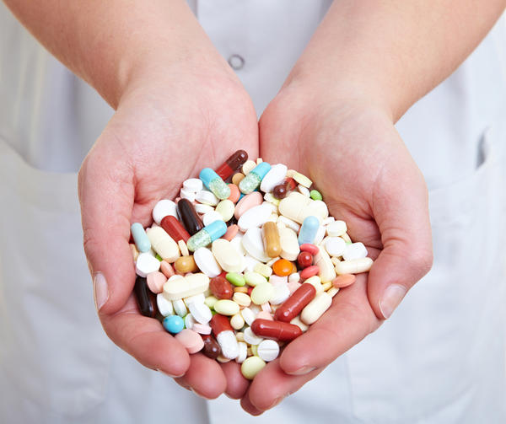
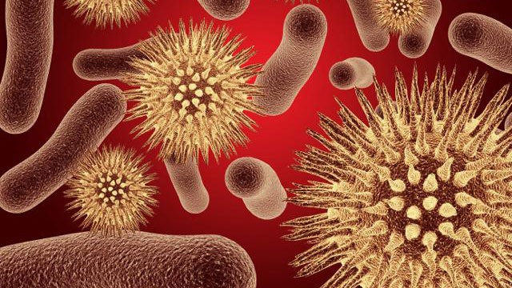
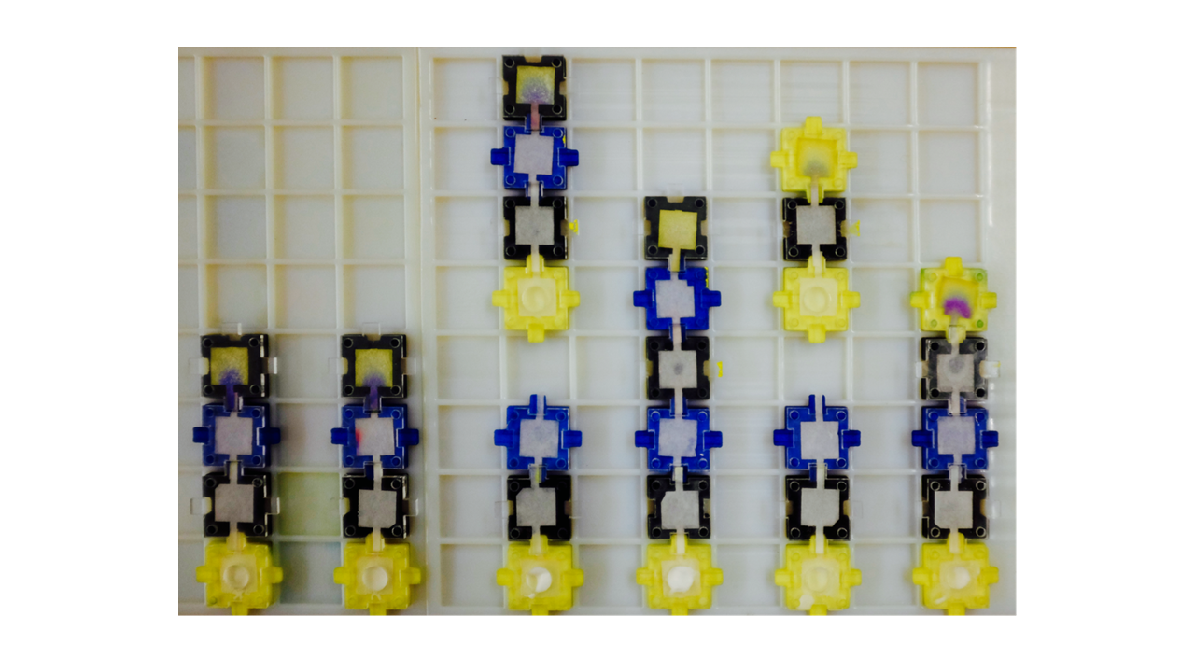
Overnight Ampli Bioreactor Activity: Antibiotic Efficacy
What makes an effective antibiotic? Write a hypothesis about what kills bacteria. Test it with Ampli, learn about antibiotics, and discuss emergent multidrug resistance

Slide 14
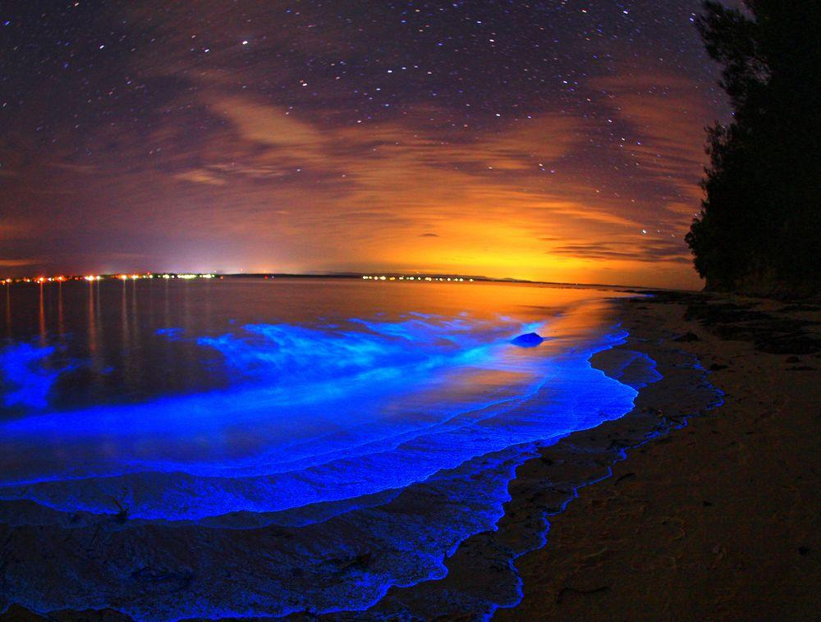
Overnight Ampli Bioreactor Activity: Marine Pollution Risk
Use visible marine microorganisms like bioluminescent plankton as indicators of ocean pollution impact, and discuss marine conservation and green industry

Slide 15
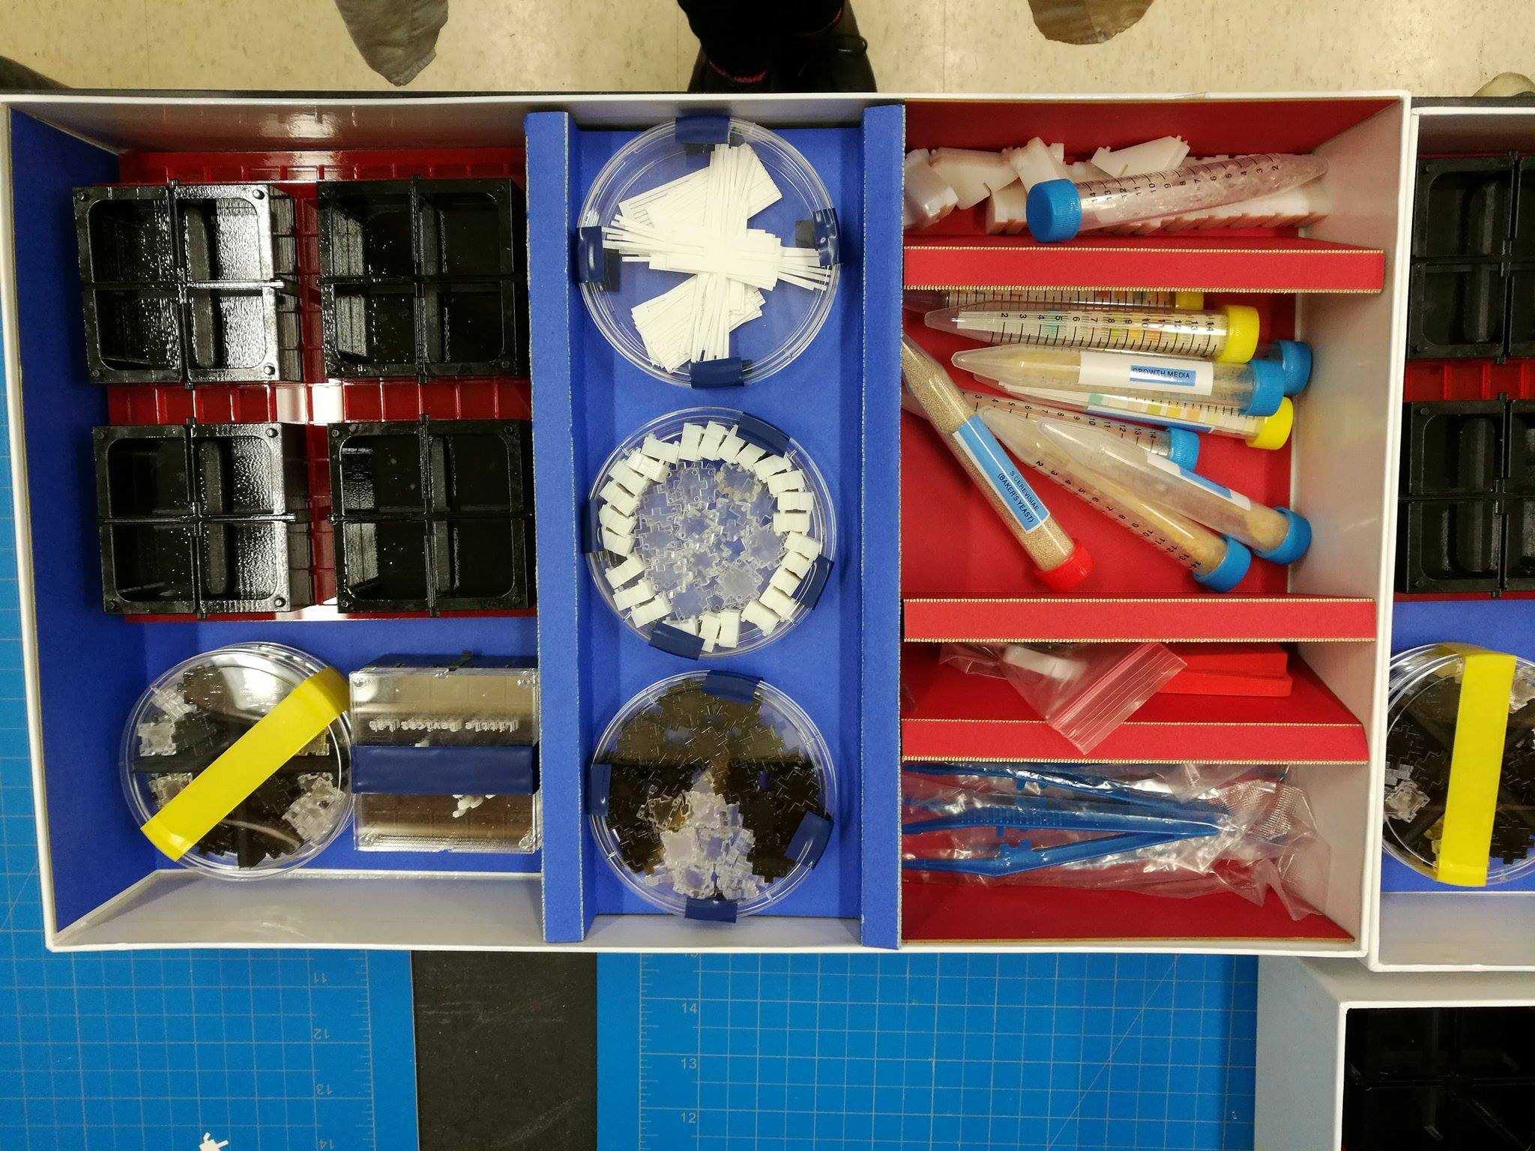
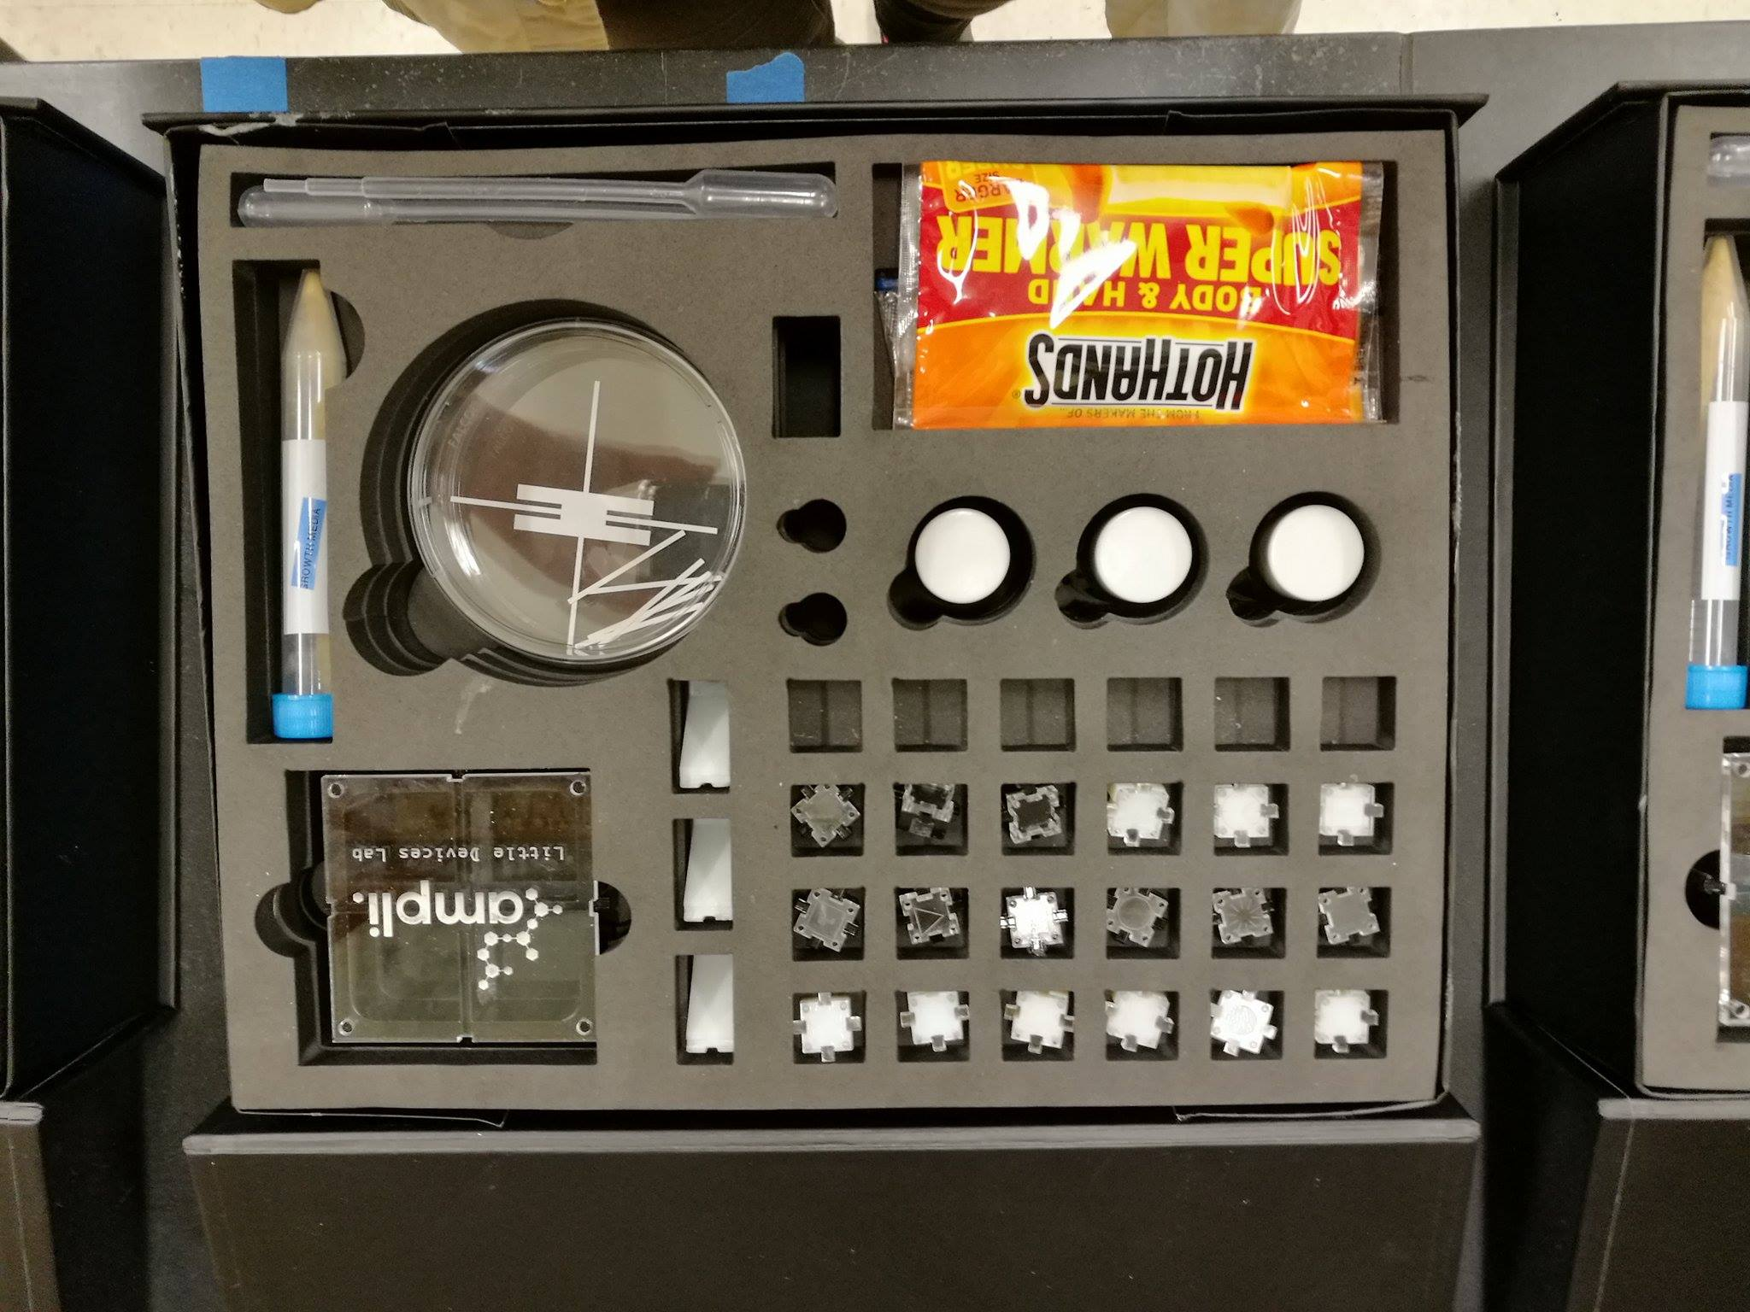
Where can I order Ampli Kits?
You can visit AmpliScience.com for information on how to order Ampli
You can contact littledevices@mit.edu for more information
By downloading the Ampli App you can receive a coupon code
How much does it cost?
Ampli Kits were designed to be affordable
Kit is around $50
*Ampli Kits go on sale on September 23rd during MakerFaire NYC but the kits will be sold ONLINE*
Notes:
Can get discount before september 23rd
*You can say this outloud with the “How much does it cost?” section*
Prices will be comparable to everyday lego prices

Slide 16
Discussion + Questions

Slide 17
